Slide 1
Transactions, Views, Indexes 事务 视图 索引
Controlling Concurrent Behavior Virtual and Materialized物化 Views Speeding Accesses to Data

Slide 2
Why Transactions?
Database systems are normally being accessed by many users or processes at the same time.
Both queries and modifications.
Unlike operating systems, which support interaction of processes, a DMBS needs to keep processes from troublesome interactions.

Slide 3
Example: Bad Interaction
You and your domestic partner each take $100 from different ATM’s at about the same time.
The DBMS better make sure one account deduction doesn’t get lost.
Compare: An OS allows two people to edit a document at the same time. If both write, one’s changes get lost.

Slide 4
Transactions
Transaction = process involving database queries and/or modification.
Normally with some strong properties regarding concurrency.
Formed in SQL from single statements or explicit programmer control.

Slide 5




ACID Transactions
ACIDtransactions are:
Atomic: Whole transaction or none is done.
Consistent: Database constraints preserved.
Isolated隔离: It appears to the user as if only one process executes at a time.
Durable: Effects of a process survive a crash.
Optional: weaker forms of transactions are often supported as well.

Slide 6
COMMIT提交
The SQL statement COMMIT causes a transaction to complete.
It’s database modifications are now permanent in the database.

Slide 7
ROLLBACK回滚
The SQL statement ROLLBACK also causes the transaction to end, but by aborting异常终止.
No effects on the database.
Failures like division by 0 or a constraint violation can also cause rollback, even if the programmer does not request it.

Slide 8



















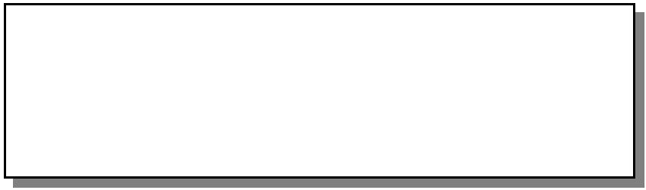









How the Transaction Log Works
Data modification is sent by application
Modification is recorded in transaction log on disk
Buffer Cache
Disk
Data pages are located in, or read into, buffer cache and modified
Disk
Checkpoint writes committed transactions
to database

Slide 9
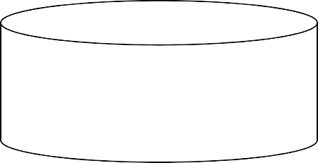







How Data Is Stored
Data (file)
.mdf or .ndf
Log (file)
.Idf
Tables, Indexes
Extent
(8 contiguous 8-KB pages)
Data Page (8 KB)
Max row size = 8060 bytes

Slide 10
Example: Interacting Processes
Assume the usual Sells(bar,beer,price) relation, and suppose that Joe’s Bar sells only Bud for $2.50 and Miller for $3.00.
Sally is querying Sells for the highest and lowest price Joe charges.
Joe decides to stop selling Bud and Miller, but to sell only Heineken at $3.50.

Slide 11
Sally’s Program
Sally executes the following two SQL statements called (min) and (max) to help us remember what they do.
(max)
SELECT MAX(price) FROM Sells WHERE bar = ’Joe’’s Bar’; SELECT MIN(price) FROM Sells WHERE bar = ’Joe’’s Bar’;
(min)

Slide 12
Joe’s Program
At about the same time, Joe executes the following steps: (del) and (ins).
(del)
DELETE FROM Sells
WHERE bar = ’Joe’’s Bar’; INSERT INTO Sells
VALUES(’Joe’’s Bar’, ’Heineken’, 3.50);
(ins)

Slide 13
Interleaving of Statements
Although (max) must come before (min), and (del) must come before (ins), there are no other constraints on the order of these statements, unless we group Sally’s and/or Joe’s statements into transactions.

Slide 14
Example: Strange Interleaving 交错
Suppose the steps execute in the order (max)(del)(ins)(min).
Joe’s Prices: Statement: Result:
{2.50,3.00}{2.50,3.00}
(max) (del) 3.00
{3.50}
(min) 3.50
(ins)
Sally sees MAX < MIN!

Slide 15
Fixing the Problem by Using Transactions
If we group Sally’s statements (max)(min) into one transaction, then she cannot see this inconsistency.
She sees Joe’s prices at some fixed time.
Either before or after he changes prices, or in the middle, but the MAX and MIN are computed from the same prices.

Slide 16
Another Problem: Rollback
Suppose Joe executes (del)(ins), not as a transaction, but after executing these statements, thinks better of it and issues a ROLLBACK statement.
If Sally executes her statements after (ins) but before the rollback, she sees a value, 3.50, that never existed in the database.

Slide 17
Solution
If Joe executes (del)(ins) as a transaction, its effect cannot be seen by others until the transaction executes COMMIT.
If the transaction executes ROLLBACK instead, then its effects can never be seen.

Slide 18
Isolation Levels
SQL defines four isolation levels = choices about what interactions are allowed by transactions that execute at about the same time.
Only one level (“serializable”) = ACID transactions.
Each DBMS implements transactions in its own way.

Slide 19
Choosing the Isolation Level
Within a transaction, we can say: SET TRANSACTION ISOLATION LEVEL X
where X =
SERIALIZABLE可序列化的
REPEATABLE READ可重复读取
READ COMMITTED
READ UNCOMMITTED

Slide 20
Serializable Transactions可序列化事务
If Sally = (max)(min) and Joe = (del)(ins) are each transactions, and Sally runs with isolation level SERIALIZABLE, then she will see the database either before or after Joe runs, but not in the middle.

Slide 21
Isolation Level Is Personal Choice
Your choice, e.g., run serializable, affects only how you see the database, not how others see it.
Example: If Joe Runs serializable, but Sally doesn’t, then Sally might see no prices for Joe’s Bar.
i.e., it looks to Sally as if she ran in the middle of Joe’s transaction.

Slide 22
Read-Commited Transactions
If Sally runs with isolation level READ COMMITTED, then she can see only committed data, but not necessarily the same data each time.
Example: Under READ COMMITTED, the interleaving (max)(del)(ins)(min) is allowed, as long as Joe commits.
Sally sees MAX < MIN.

Slide 23
Repeatable-Read Transactions
Requirement is like read-committed, plus: if data is read again, then everything seen the first time will be seen the second time.
But the second and subsequent reads may see more tuples as well.

Slide 24
Example: Repeatable Read
Suppose Sally runs under REPEATABLE READ, and the order of execution is (max)(del)(ins)(min).
(max) sees prices 2.50 and 3.00.
(min) can see 3.50, but must also see 2.50 and 3.00, because they were seen on the earlier read by (max).

Slide 25
Read Uncommitted
A transaction running under READ UNCOMMITTED can see data in the database, even if it was written by a transaction that has not committed (and may never).
Example: If Sally runs under READ UNCOMMITTED, she could see a price
3.50 even if Joe later aborts.

Slide 26





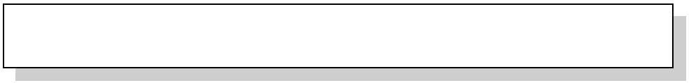
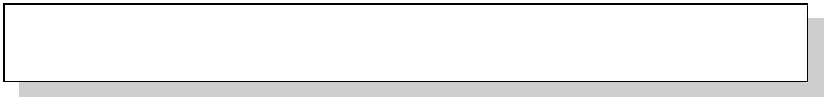


Determining Which Type of Constraint to Use
DEFAULT CHECK REFERENTIAL PRIMARY KEY UNIQUE FOREIGN KEY CHECK
Domain
Entity Referential

Slide 27


DEFAULT Constraints
Apply Only to INSERT Statements
Only One DEFAULT Constraint Per Column
Cannot Be Used with IDENTITY Property
or rowversion Data Type
Allow Some System-supplied Values
ALTER TABLE dbo.Customers ADD
CONSTRAINT DF_contactname DEFAULT 'UNKNOWN' FOR ContactName

Slide 28

CHECK Constraints
Are Used with INSERT and UPDATE Statements
Can Reference Other Columns in the Same Table
Cannot:
Be used with the rowversion data type
Contain subqueries
ALTER TABLE dbo.Employees ADD
CONSTRAINT CK_birthdate
CHECK (BirthDate > '01-01-1900' AND BirthDate < getdate())

Slide 29

PRIMARY KEY Constraints
Only One PRIMARY KEY Constraint Per Table
Values Must Be Unique
Null Values Are Not Allowed
Creates a Unique Index on Specified Columns
ALTER TABLE dbo.Customers ADD
CONSTRAINT PK_Customers
PRIMARY KEY NONCLUSTERED (CustomerID)

Slide 30
UNIQUE Constraints
Allow One Null Value
Allow Multiple UNIQUE Constraints on a Table
Defined with One or More Columns
Enforced with a Unique Index
ALTER TABLE dbo.Suppliers ADD
CONSTRAINT U_CompanyName
UNIQUE NONCLUSTERED (CompanyName)

Slide 31
FOREIGN KEY Constraints
Must Reference a PRIMARY KEY or UNIQUE Constraint
Provide Single or Multicolumn Referential Integrity
Do Not Automatically Create Indexes
Users Must Have SELECT or REFERENCES Permissions on Referenced Tables
Use Only REFERENCES Clause Within Same Table
ALTER TABLE dbo.Orders
ADD CONSTRAINT FK_Orders_Customers FOREIGN KEY (CustomerID)
REFERENCES dbo.Customers(CustomerID)

Slide 32





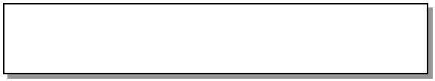
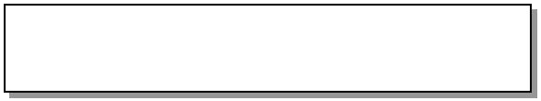
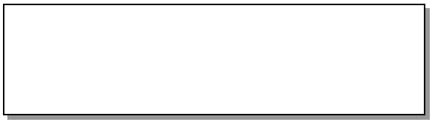












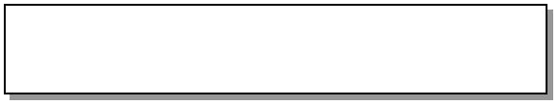





Cascading Referential Integrity
NO ACTION CASCADE
CustomerID (PK)
CustomerID (PK)
INSERT new CustomerID
UPDATE CustomerID
CASCADE
CustomerID (FK)
CustomerID (FK)
UPDATE old CustomerID to new CustomerID
CustomerID (PK)
DELETE old CustomerID

Slide 33




Using Defaults and Rules
As Independent Objects They:
Are defined once
Can be bound to one or more columns or user-defined data types
CREATE DEFAULT phone_no_default AS '(000)000-0000'
GO
EXEC sp_bindefault phone_no_default, 'Customers.Phone'
CREATE RULE regioncode_rule
AS @regioncode IN ('IA', 'IL', 'KS', 'MO') GO
EXEC sp_bindrule regioncode_rule, 'Customers.Region'

Slide 34






















Deciding Which Enforcement Method to Use
Constraints
Medium
Low
Before
Defaults and rules Low
Low
Before
Triggers
High
Medium-High
After
Data types, Null/Not Null
Low
Low
Before

Slide 35
Views
A view is a relation defined in terms of stored tables (called basetables) and other views.
Two kinds:
Virtual = not stored in the database; just a query for constructing the relation.
Materialized = actually constructed and stored.

Slide 36
Declaring Views
Declare by:
CREATE [MATERIALIZED] VIEW
<name> AS <query>;
Default is virtual.

Slide 37



Example: View Definition
CanDrink(drinker, beer) is a view “containing” the drinker-beer pairs such that the drinker frequents at least one bar that serves the beer:
CREATE VIEW CanDrink AS SELECT drinker, beer FROM Frequents, Sells
WHERE Frequents.bar = Sells.bar;

Slide 38
Example: Accessing a View
Query a view as if it were a base table.
Also: a limited ability to modify views if it makes sense as a modification of one underlying base table.
Example query:
SELECT beer FROM CanDrink
WHERE drinker = ’Sally’;

Slide 39

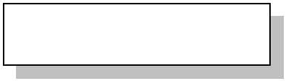

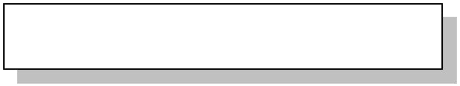


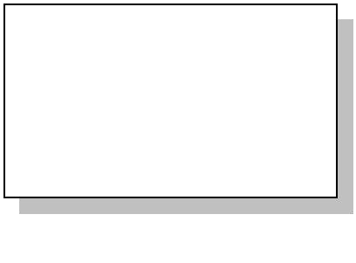
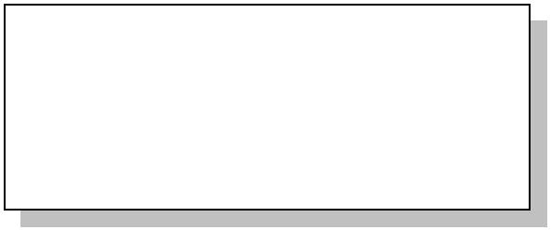



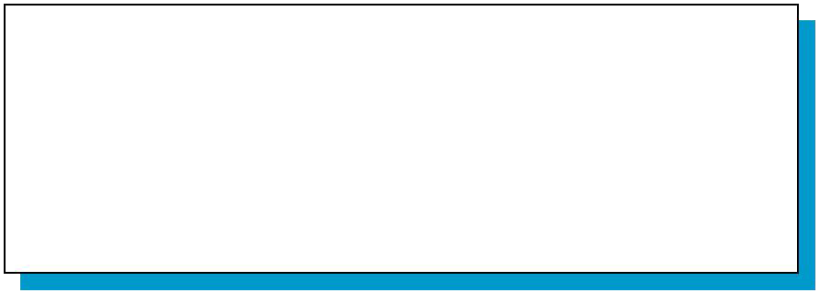


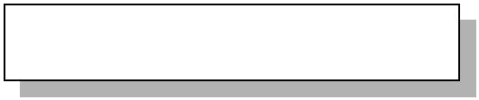
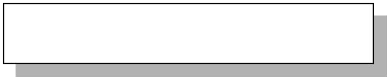
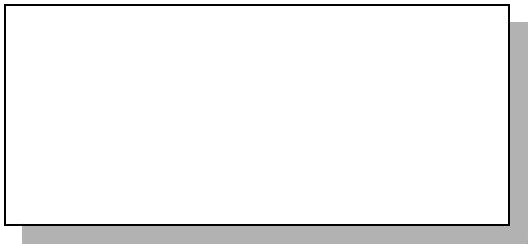



Using Views
EmployeeID LastName
Davolio
Fuller
3
Firstname
Nancy Andrew Janet
Title
~~~
~~~
~~~
Leverling
CREATE VIEW dbo.EmployeeView AS
SELECT LastName, Firstname FROM Employees
Lastname
Davolio Fuller Leverling
Firstname
Nancy Andrew Janet

Slide 40





















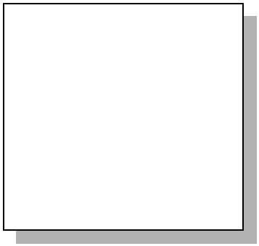














Example: View of Joined Tables
Orders Customers
10663 | BONAP | 19~9~7~-09-24 | 1997-10-03 | BONAP | Bon app' | Laurence Lebihan
10827 | BONAP | 19~9~8~-01-26 | 1998-02-06 | PICCO | Piccolo und mehr | Georg Pipps
10427 | PICCO | 19~9~7~-02-24 | 1997-03-03 | QUICK | QUICK-Stop | Horst Kloss
10451 | QUICK | 19~9~7~-03-05 | 1997-03-12
10515 | QUICK | 19~9~7~-05-07 | 1997-05-23
ShipStatusView
CREATE VIEW dbo.ShipStatusView AS
SELECT OrderID, RequiredDate, ShippedDate, ContactName
FROM Customers c INNER JOIN Orders o ON c.CustomerID = O.CustomerID
WHERE RequiredDate < ShippedDate
10264 199169-0698-2803-21 Laurence Lebihan
10271 199169-0698-3800-29 Georg Pipps
10280 199169-0699-1902-11 Horst Kloss

Slide 41

Advantages of Views
Focus the Data for Users
Focus on important or appropriate data only
Limit access to sensitive data
Mask Database Complexity
Hide complex database design
Simplify complex queries, including distributed queries to heterogeneous data
Simplify Management of User Permissions
Improve Performance
Organize Data for Export to Other Applications

Slide 42
Triggers on Views
Generally, it is impossible to modify a virtual view, because it doesn’t exist.
But an INSTEAD OF trigger lets us interpret view modifications in a way that makes sense.
Example: View Synergy has (drinker, beer, bar) triples such that the bar serves the beer, the drinker frequents the bar and likes the beer.
42

Slide 43
Example: The View
Pick one copy of each attribute
CREATE VIEW Synergy AS
SELECT
Likes.drinker, Likes.beer, Sells.bar
FROM Likes, Sells, Frequents
WHERE Likes.drinker = Frequents.drinker AND Likes.beer = Sells.beer
AND Sells.bar = Frequents.bar;
Natural join of Likes, Sells, and Frequents
43

Slide 44
Interpreting a View Insertion
We cannot insert into Synergy --- it is a virtual view.
But we can use an INSTEAD OF trigger to turn a (drinker, beer, bar) triple into three insertions of projected pairs, one for each of Likes, Sells, and Frequents.
Sells.price will have to be NULL.

Slide 45




The Trigger
CREATE TRIGGER ViewTrig INSTEAD OF INSERT ON Synergy REFERENCING NEW ROW AS n FOR EACH ROW
BEGIN
INSERT INTO LIKES VALUES(n.drinker, n.beer); INSERT INTO SELLS(bar, beer) VALUES(n.bar, n.beer); INSERT INTO FREQUENTS VALUES(n.drinker, n.bar);
END;

Slide 46
Materialized Views
Problem: each time a base table changes, the materialized view may change.
Cannot afford to recompute the view with each change.
Solution: Periodic reconstruction of the materialized view, which is otherwise “out of date.”

Slide 47
Example: Axess/Class Mailing List
The class mailing list cs145-aut0708- students is in effect a materialized view of the class enrollment in Axess.
Actually updated four times/day.
You can enroll and miss an email sent out after you enroll.

Slide 48
Example: A Data Warehouse数据仓库
Wal-Mart stores every sale at every store in a database.
Overnight, the sales for the day are used to update a datawarehouse = materialized views of the sales.
The warehouse is used by analysts to predict trends and move goods to where they are selling best.

Slide 49

Indexes
Index = data structure used to speed access to tuples of a relation, given values of one or more attributes.
Could be a hash table, but in a DBMS it is always a balanced search tree with giant nodes (a full disk page) called a
B- tree.

Slide 50
Using Clustered Indexes 聚集索引
Each Table Can Have Only One Clustered Index
The Physical Row Order of the Table and the Order of Rows in the Index Are the Same
Key Value Uniqueness唯一性 Is Maintained Explicitly显示
or Implicitly

Slide 51
Using Nonclustered Indexes
Nonclustered Indexes Are the SQL Server Default
Existing Nonclustered Indexes Are Automatically Rebuilt When:
An existing clustered index is dropped
A clustered index is created
The DROP_EXISTING option is used to change which columns define the clustered index

Slide 52




Declaring Indexes
No standard!
Typical syntax:
CREATE INDEX BeerInd ON
Beers(manf);
CREATE INDEX SellInd ON
Sells(bar, beer);

Slide 53
Using Indexes
Given a value v, the index takes us to only those tuples that have v in the attribute(s) of the index.
Example: use BeerInd and SellInd to find the prices of beers manufactured by Pete’s and sold by Joe. (next slide)

Slide 54
Using Indexes --- (2)
SELECT price FROM Beers, Sells WHERE manf = ’Pete’’s’ AND
Beers.name = Sells.beer AND bar = ’Joe’’s Bar’;
Use BeerInd to get all the beers made by Pete’s.
Then use SellInd to get prices of those beers, with bar = ’Joe’’s Bar’

Slide 55

















Finding Rows Without Indexes
sysindexes
id indid = 0 First IAM
IAM
E…xtent Bit Map
127 1
128 1
129 0
130 1
…
Heap
Extent 127
Extent 128
Extent 129
Extent 130
⁰0¹1 ^{C}Rºu^{n}dd
……
0₀1₁ D_{R}u_{u}n_{d}n_{d} ……
0₀1₁ S_{R}e_{u}a_{d}tt_{d}le ……
0₀1₁ G_{R}ra_{u}f_{d}f_{d} ……
02⁰0¹1Fu^{A}nS^{k}km^{ht}iªth^{r}………
02⁰0¹1Ra^{A}nS^{k}dm^{h}a^{t}iªltlh^{r}………
02⁰0¹1Pa^{A}rSi^{k}sm^{ht}iªth^{r}………
02⁰0¹1Ba^{A}cS^{k}om^{h}n^{t}iªth^{r}………
0₀2₂0₀1W_{1F}h_{u}Ci_{n}t_{R}eo_{ku}n_{dd}…………
0₀2₂0₀1W_{1F}h_{u}Ci_{n}t_{R}eo_{ku}n_{dd}…………
0₀2₂0₀1W_{1F}h_{u}Ci_{n}t_{R}eo_{ku}n_{dd}…………
0₀2₂0₀1W_{1F}h_{u}Ci_{n}t_{R}eo_{ku}n_{dd}…………
0₀3₃0₀2W_{2B}0h_{a0}1Oi_{r1}t_{F}e_{r}ta_{u}A_{nS}k_{k}…_{m}h…t_{i}a_{t}…_{h}r………
0₀3₃0₀2O_{2B}0ta₀1O_{r1Fr}ta_{u}A_{nS}k_{k}…_{m}h…t_{i}a_{t}…_{h}r………
0₀3₃0₀2T_{2B}o0k_{a0}1Oy_{r1Fr}ota_{u}A_{nS}k_{k}…_{m}h…t_{i}a_{t}…_{h}r………
0₀3₃0₀2K_{2B}o0_{a0}c1O_{r1}h_{Fr}ta_{u}A_{nS}k_{k}…_{m}h…t_{i}a_{t}…_{h}r………
04⁰0³3D⁰0u^{2S}2rJ^{m}koi^{W}n^{i}n^{t}F^{h}e^{h}us^{i}.n^{t}.^{e}.k…………
04⁰0³3S⁰l0²i^{S}c2J^{m}hot^{Wi}ne^{t}F^{h}er^{h}us^{i}.n^{t}.^{e}.k…………
04⁰0³3A⁰t0^{2S}la2J^{m}not^{Wi}na^{t}F^{h}e^{h}us^{i}.n^{t}.^{e}.k…………
…⁰0³3.⁰..0^{2S}2J^{m}o^{Wi}n^{t}F^{h}e^{h}us^{i}.n^{t}.^{e}.k…………
…₀₄0₀3.._{3M}.02_{a}W_{Brt}h_{ian}Oi_{r}te_{r}ta......………
…₀₄0₀3.._{3M}.02_{a}W_{Brt}h_{ian}Oi_{r}te_{r}ta......………
…₀₄0₀3.._{3M}.02_{a}W_{Brt}h_{ian}Oi_{r}te_{r}ta......………
…₀₄0₀3.._{3M}.02_{a}W_{Brt}h_{ian}Oi_{r}te_{r}ta......………
0…5 ……L.a0..n₀3…g_{3...}S_{J}m_{o}..i_{n.}.t.h_{e.}._{s}.....……
0…5 ……L.a0..B₀3…₃r..ie.S_{J}m_{o}..i_{n.}.t.h_{e.}._{s}.....……
…………...^{.0}..0^{3…}3...^{S}J^{m}o^{..i}n.^{.t}.^{h}e..s.....……
…………...^{.0}..0^{3…}3...^{S}J^{m}o^{..i}n.^{.t}.^{h}e..s.....……
………0..4......M. arti.n...........
………0..4......M. arti.n...........
………0..4......M. arti.n...........
………0..4......M. arti.n...........
………......… .........
………......… .........
………......… .........
………......… .........
…… ......
......
…… ......
......
…… ......
......
…… ......
......

Slide 56









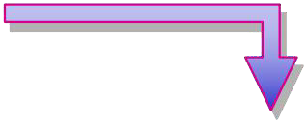




































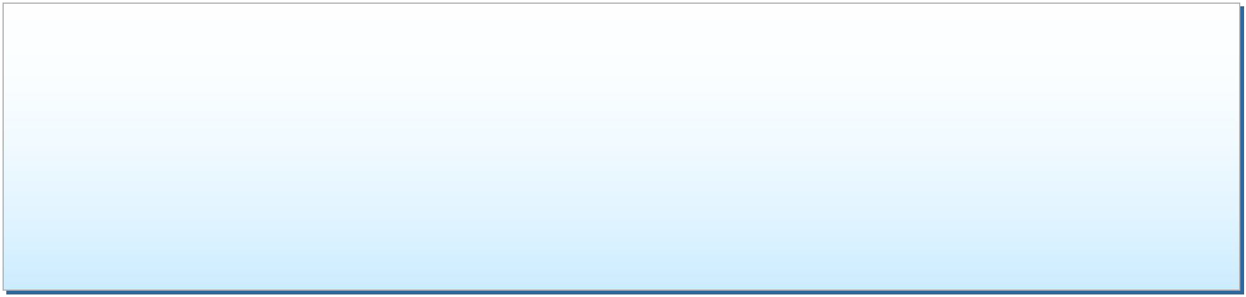
















Finding Rows in a Heap with a Nonclustered Index
sysindexes
id indid = 2 root
Akhtar
...
Non clustered
Index
Non
^{Akhtar Non-Leaf} Clustered
... Level
SELECT l^{M}a^{ar}s^{tin}tname, firstname ^{Index}
Page 37 _{Page 12 - Root} Page 28
AkhtaFr ROM member Martin
^{Ganio}WHERE lastname ^{Smith}
... ...
BETWEEN 'Masters' AND 'Rudd'
Page 41 Page 51 Page 61 Page 71 Leaf Level
Akhtar 4:706:01 Ganio 4:709:01 Martin 4:708:01 Smith 4:706:03 (Key Value)
Barr 4:705:03 Hall 4:709:04 Matey 4:706:04 Smith 4:708:04
Con 4:704:01 Jones 4:709:02 Ota 4:707:02 Smith 4:707:01
Funk 4:706:02 Jones 4:708:03 Phua 4:708:02 White 4:704:03
Funk 4:704:02 Jones 4:707:03 Rudd 4:705:01 White 4:705:02
Non-Leaf
Level
Page 37 Akhtar Ganio
...
Martin
Page 28
Page 12 - Root
Martin
Smith
...
Page 41
Akhtar 4:706:01
Barr 4:705:03
Page 51
Ganio 4:709:01
Hall 4:709:04
Jones 4:709:02
Jones 4:708:03
Jones 4:707:03
Page 61
Page 71
Leaf Level
Martin 4:708:01
Smith 4:706:03 (Key Value)
Smith 4:708:04
Smith 4:707:01
White 4:704:03
White 4:705:02
Matey
4:706:04
Con 4:704:01
Funk 4:706:02
Funk 4:704:02
Ota
4:707:02
Phua
4:708:02
Rudd
4:705:01
Heap
Page 704
Page 705
Page 706
Page 707
Page 808
Page 709
01 ... | Conn |  |  | 01 | ... | Akhtar | 01 | ... | Smith | 01 | ... | Martin | 01 | ... Ganio
02 ... | Funk | 02 ... | White | 02 | ... | Funk |  |  |  |  |  |  | 02 | ... Jones
03 ... | White | 03 ... | Barr | 03 | ... | Smith | 03 | ... | Jones | 03 | ... | Jones | 03 | ... Hall
... ... | ... | ... ... | ... |  |  |  | ... | ... | ... | 04 | ... | Smith | ... | ... ...
... ... | ... | ... ... | ... | ... | ... | ... | ... | ... | ... | ... | ... | ... | ... | ... ...
0011
......
RRuudddd
0022
......
OOttaa
0022
......
PPhhuuaa
0044
......
MMaatteeyy
File I
D
File I
#4
#4

Slide 57



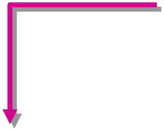














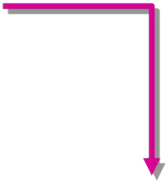














Finding Rows in a Clustered Index
sysindexes
id indid = 1 root
Clustered Index
Clustered Index
Akhtar
… Martin
SEL^{Ak}E^{ht}C^{ar}T lastn^{Page 140 - Root} tname ^{Martin}
Ganio ^{ame, firs} Smith
FROM member …
W_{Pa}H_{g}E_{e} R₁₄E₁ lastname = 'Ota' _{Page 145}
Akhtar 2334 ... Ganio 7678 ... Martin 1234 ... Smith 1434 ...
Barr 5678 ... Hall 8078 ... Martin 7778 ... Smith 5778 ...
Con 2534 ... Jones 2434 ... Ota 5878 ... Smith 7978 ...
Funk 1334 ... Jones 5978 ... Phua 7878 ... White 2234 ...
Funk 1534 ... Jones 2634 ... Rudd 6078 ... White 1634 ...
... ... ... ... ... ... ... ... ... ... ... ...
Page 100 Page 110 Page 120 Page 130
Akhtar
… Martin
Page 140 - Root
Akhtar Ganio
Martin Smith
…
Page 145
Page 141
Akhtar Barr Con Funk Funk
...
2334 ...
5678 ...
2534 ...
1334 ...
1534 ...
... ...
Ganio Hall Jones Jones Jones
...
7678 ...
8078 ...
2434 ...
5978 ...
2634 ...
... ...
Martin Martin Ota Phua Rudd
...
1234 ...
7778 ...
5878 ...
7878 ...
6078 ...
... ...
Smith Smith Smith White White
...
1434 ...
5778 ...
7978 ...
2234 ...
1634 ...
... ...
Page 100
Page 110
Page 120
Page 130

Slide 58

















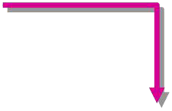













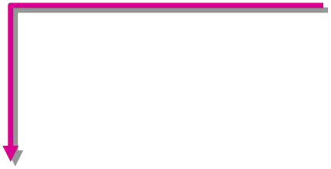












Finding Rows in a Clustered Index with a Nonclustered Index
sysindexes
id indid = 2 root
Aaron
...
Jose
Nonclustered Index on First Name
Nonclustered
_{Index on Aaron} Non-Leaf
First Name ... ^{Level}
Jose
Aaron Jose
SELEC_{D}T_{ea}l_{nn}a_{a}stname, firstna_{Ni}m_{na}e, phone
FROM …member …
WHERE firstname = 'Mike'
Aaron Con Deanna Daum Jose Lugo Leaf Level
Adam Barr Don Hall Judy Kaethler (Clustered
Amie Baldwin Doug Hampton Mike Nash ^{Key Value)}
… … … … … …
Non-Leaf
Level
Aaron Deanna
…
Jose Nina
…
Aaron Con
Adam Barr
Amie Baldwin
… …
Deanna Daum Don Hall
Doug Hampton
… …
Jose Lugo
Judy Kaethler
Mike Nash
… …
Leaf Level (Clustered Key Value)
Clustered Index On Last Name
Barr Adam …
Cox Arlette … Daum Deanna …
… …
Barr Kim Nagata O’Melia
Kim Shane …
Kobara Linda …
LaBrie Ryan …
… …
Nagata Susanne … Nash Mike …
Nixon Toby …
… … …
…
…

Slide 59
Database Tuning
A major problem in making a database run fast is deciding which indexes to create.
Pro: An index speeds up queries that can use it.
Con: An index slows down all modifications on its relation because the index must be modified too.

Slide 60
Example: Tuning
Suppose the only things we did with our beers database was:
Insert new facts into a relation (10%).
Find the price of a given beer at a given bar (90%).
Then SellInd on Sells(bar, beer) would be wonderful, but BeerInd on Beers(manf) would be harmful.

Slide 61
Tuning Advisors
A major research thrust研究方向.
Because hand tuning is so hard.
An advisor gets a queryload, e.g.:
Choose random queries from the history of queries run on the database, or
Designer provides a sample workload.

Slide 62
Tuning Advisors调整顾问
The advisor generates candidate indexes and evaluates each on the workload.
Feed each sample query to the query optimizer, which assumes only this one index is available.
Measure the improvement/degradation in the average running time of the queries.

